Slide 1


Cryptography
The science of hiding information, most commonly by encoding and decoding a secret code used to send messages.
Based on mathematics and computer science.
Protects data in transit and data at rest.
Greetings, Mr. Logawps,
We received your request for information and will be happy to oblige. Here is your user name and password:
Encoding
Decoding
G7JDZL L59CZ2 AA9CZ1
ZPQ12G 93D2BA LP7FFH
18ABHF UJ14A3 34FYO5
K71TYP CS1314 566HXH

Slide 2
Cryptography Elements
Cryptography Element | Description
Confusion | Relationship between ciphertext and encryption key is complex and opaque. Prevents attackers from looking for patterns between ciphertext and plaintext.
Diffusion | Ciphertext changes drastically on slightest change to plaintext input. Prevents attackers from determining parts of message encrypted by same key.
Collision | Two different plaintext inputs produce same exact ciphertext. Weakens integrity and enables attacker to replace one message with another.
Obfuscation | Similar to encryption, but no key involved, and not as secure. Anyone who knows the obfuscation algorithm can de-obfuscate the code.
PRNG | An algorithm produces numbers that approximate true randomness. Based on seed state, which is passed into a formula to produce the number. Key generation tends to use pseudorandom numbers.
PFS | If a key is compromised, past sessions encrypted by the key will not be affected. Prevents attackers from decrypting previous sessions if they steal the key.

Slide 3
Encryption and Decryption
Encryption: A security technique that converts data from plaintext form into coded (or ciphertext) form so that only authorized parties with the necessary decryption information can decode and read the data.
Plaintext: Unencrypted data that is meant to be encrypted before transmission, or the result of decrypting encrypted data.
Ciphertext: Encoded, unreadable data.
Decryption: A cryptographic technique that converts ciphertext to plaintext.
Cleartext: Unencrypted, readable data that is not meant to be encrypted.
Only authorized parties with decryption information can read encrypted files.
One-way encryption is not meant to be decrypted.
Two-way encryption is meant to be decrypted.
Decryption
Plaintext
Plaintext

Slide 4




Encryption and Decryption (Cont.)
Plaintext
Encryption
Ciphertext
Ciphertext
Decryption
Plaintext
Plaintext

Slide 5
Encryption and Security Goals
Confidentiality
Integrity
Non-repudiation
Authentication
Access control
Plaintext
Encryption
Ciphertext

Slide 6




Ciphers
Cipher: An algorithm used to encrypt or decrypt data.
Enciphering: The process of translating plaintext to ciphertext.
Deciphering: The process of translating ciphertext to plaintext.
Ciphers alter individual letters or bits to scramble a message.
Codes alter words or phrases, or resemble a secret language.
The science of breaking codes and ciphers is called cryptanalysis.
Original Information
Cipher
Encrypted Information

Slide 7
A Key
A specific piece of information that is used in conjunction with an algorithm to perform encryption and decryption.
Different keys produce different ciphertext.
For each algorithm, longer keys provide stronger encryption.
Static and ephemeral keys.
Original Information
Cipher
Encrypted Information
= Two Letters Following

Slide 8
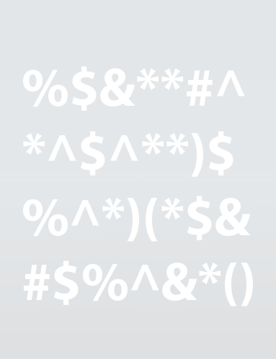

Symmetric Encryption
A two-way encryption scheme in which encryption and decryption are both performed by the same key (shared key encryption).
Hardware keys and software keys.
Before encrypted communications begin, the key must be securely shared.
Fast, but vulnerable if the key is lost or compromised.
Common alternate names
Secret key
Shared key
Private key
Encrypts Data
Decrypts Data
Same Key on Both Sides

Slide 9
Asymmetric Encryption
Asymmetric encryption: A two-way encryption scheme that uses paired public and private keys.
Private key: The component of asymmetric encryption that is kept secret by one party during two-way encryption.
Public key: The component of asymmetric encryption that can be accessed by anyone.
Key generation: The process of producing a public and private key pair by using a specific application.

Slide 10


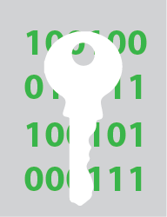
Asymmetric Encryption (Cont.)
Public Key Encrypts
Private Key Decrypts

Slide 11
Hashing
Hashing: A process or function that transforms plaintext to ciphertext that cannot be directly decrypted.
Hash, hash value, or message digest: The value that results from hashing encryption.
Used in several password authentication schemes.
Used in digital signatures.
Used for verifying file integrity.
Message
Digest
HASH FUNCTION
6TE3 13LO P429 HJL7 AVGN
08JN D1UL 4Y89 MM20 CSN7
10B7 552F Q8LW 80VT VX4Y
PLBZ FR3X TX53 LL01 5320
"Secret"
"Keep this secret"
HASH FUNCTION
VV30 542A 77VX X2TY UL34
JJLD 72WE R2E4 JOP7 N421
HJP4 EWQ1 HG8X LA91 00B1
SS75 5YFC M72A 9LQE 762A

Slide 12
Hashing Concepts
Cryptographic salt: A random value added to plaintext input during password hashing.
Drastically changes message digest.
If the salt changes, the same input with different salts will produce different digests.
Salt is stored with message digests and is not hidden.
Attacker will need to generate unique rainbow tables to account for the salt.
Rainbow table attacks therefore become ineffective.
Nonces don't repeat, but a salt can.
Nonces used primarily in authentication protocols to prevent replay attacks.
Nonce: Similar to salt, but is a "number used only once."

Slide 13
Data States
Data at rest: Data stored on various media.
Software and hardware can encrypt data at rest.
In a breach, the data remains protected.
Encrypting data in transit prevents man-in-the-middle attacks.
Secures transmission channel and data flowing through it.
Unencrypted sessions during use can put the data at risk.
Some mechanisms can encrypt the data in memory.
Data in transit: Data that moves from medium to medium.
Data in use: Data currently being created, deleted, read, or modified.

